Slide 1



Website Management
Content Transfers
Notes:
Michael

Slide 2
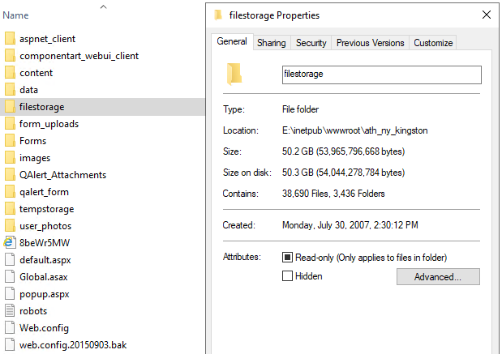
Content Transfer Issues
It is all about time
63,000 content items
Copy Paste
Download
Upload
Click Click Click
Multiple Content Management Systems
All-Net
QContent
….
Notes:
Scott

Slide 3
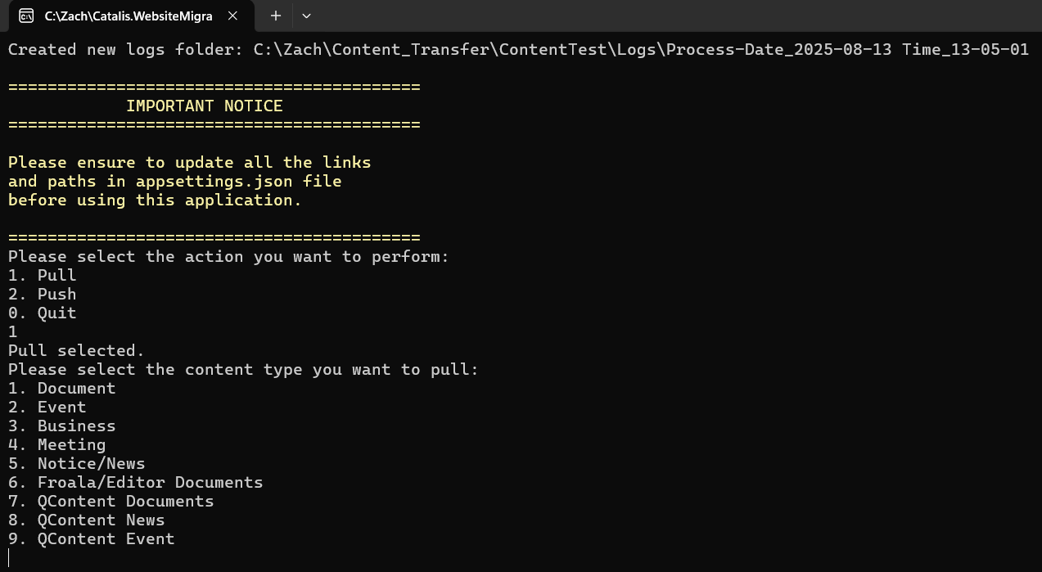

2 Part Solution
Pull Windows Console Application
Content Types
Documents
Event
Business
Meeting
Notices & News
Notes:
Scott

Slide 4
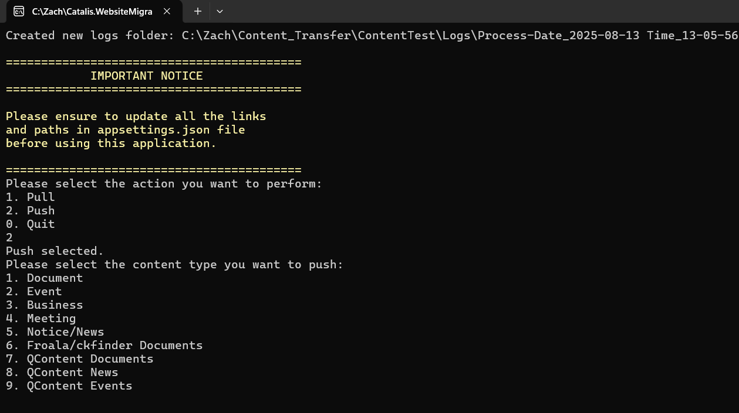
2 Part Solution
Push Windows Console Application
Content Types
Documents
Event
Business
Meeting
Notices & News
Notes:
Scott

Slide 5
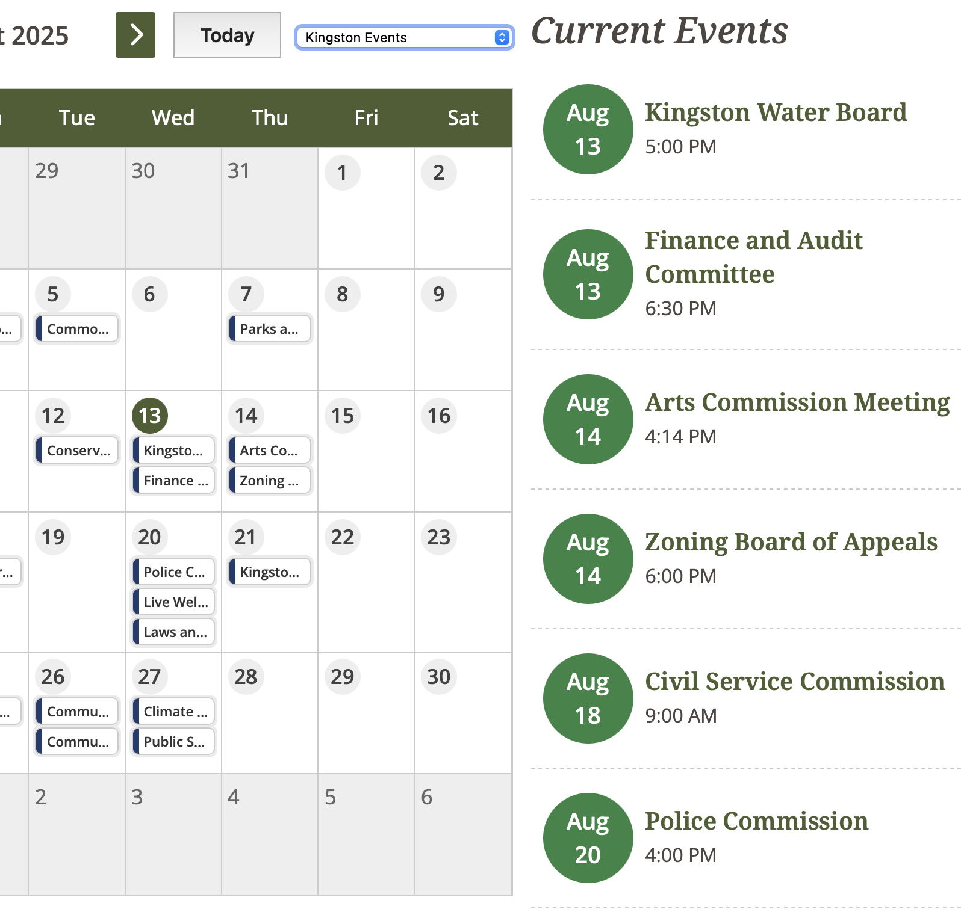
Highlights
All-Net
20+ Sites
Average is less than a day to move
Hand-Off to Implementations
QContent
50 GB of Upload Files
38,690 Files, 3,436 folders
20,000+ Calendar Items
20,000+ News Items
Notes:
Scott

Slide 7









Content Transfer Solution
Moving content from All-Net to the Catalis Platform
via text or mobile app
on the web
on the phone (IVR & TTY)
at a kiosk
with a live agent
City of Chandler
at the counter
at a retail location
Notes:
Scott

Slide 8
57%
The majority of cryptocurrency investors have the appetite to spend their holdings on goods and services with 57% wanting to do so in the next year
Lack of businesses accepting crypto is the dominant factor for investors not having used cryptocurrency as a payment method already
52% of cryptocurrency investors have expressed interest in spending their holdings within the retail & grocery industries

Slide 9
Retail investors exhibited clear appetite to spend cryptocurrency, however, lack of businesses currently accepting is a major hinderance
41%
Of crypto holders have purchased goods or services using cryptocurrency
73%
Of crypto holders who haven’t already used cryptocurrency to purchase good or services would like to in the future
In a recent market study ~100,000 cryptocurrency investors were surveyed on their appetite to make cryptocurrency payments for goods and services. The survey includes key details around payment preferences, appetite timeline and reasons for / for not wanting to use a cryptocurrency payment solution.

Slide 10
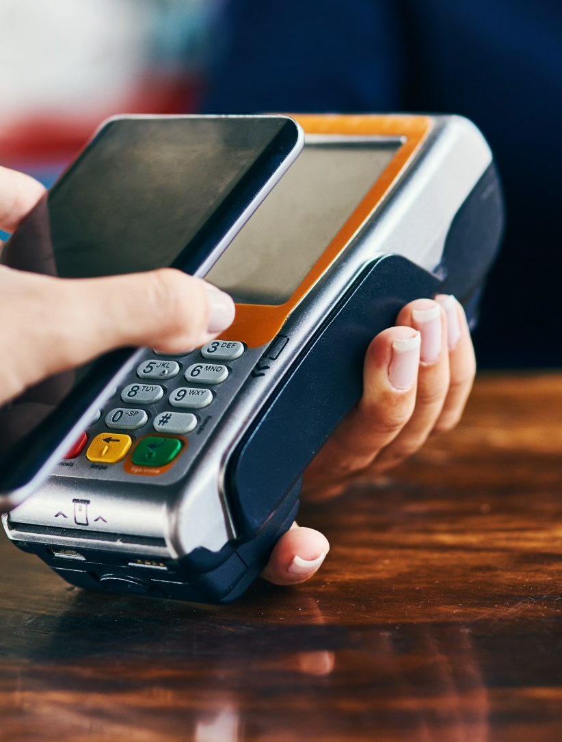
Available Payment Channels
CONTACTLESS IN-PERSON PAYMENTS
Wide breadth of terminal options
In-person and in-the-field processing
Digital wallet & wearables payments
Eliminate handling of credit / debit cards by staff
Integration to cashiering systems API
Expect to use contactless cards more than pre-pandemic
Notes:
Scott

Slide 11

City of Chandler
REQUEST FOR PROPOSAL MS2-920-4380
A CATALIS PRODUCT
Notes:
Michael

